Slide 1

TeaSpot
“Great start Your Morning!..”

Slide 2
TABLE OF CONTENTS
1
Landing Page
You could describe the topic of the section
2
About-us
You could describe the topic of the section
3
Product
You could describe the topic of the section
4
Reviews
You could describe the topic of the section
5
Contact
You could describe the topic of the section

Slide 3

OUR COMPANY
Welcome to our tea website, where we celebrate the art and tradition of tea. We are passionate about sharing our love for tea with you and providing you with the highest quality teas from around the world.
COMPANY LOGO
TeaSpot

Slide 4


Landing Page

Slide 5
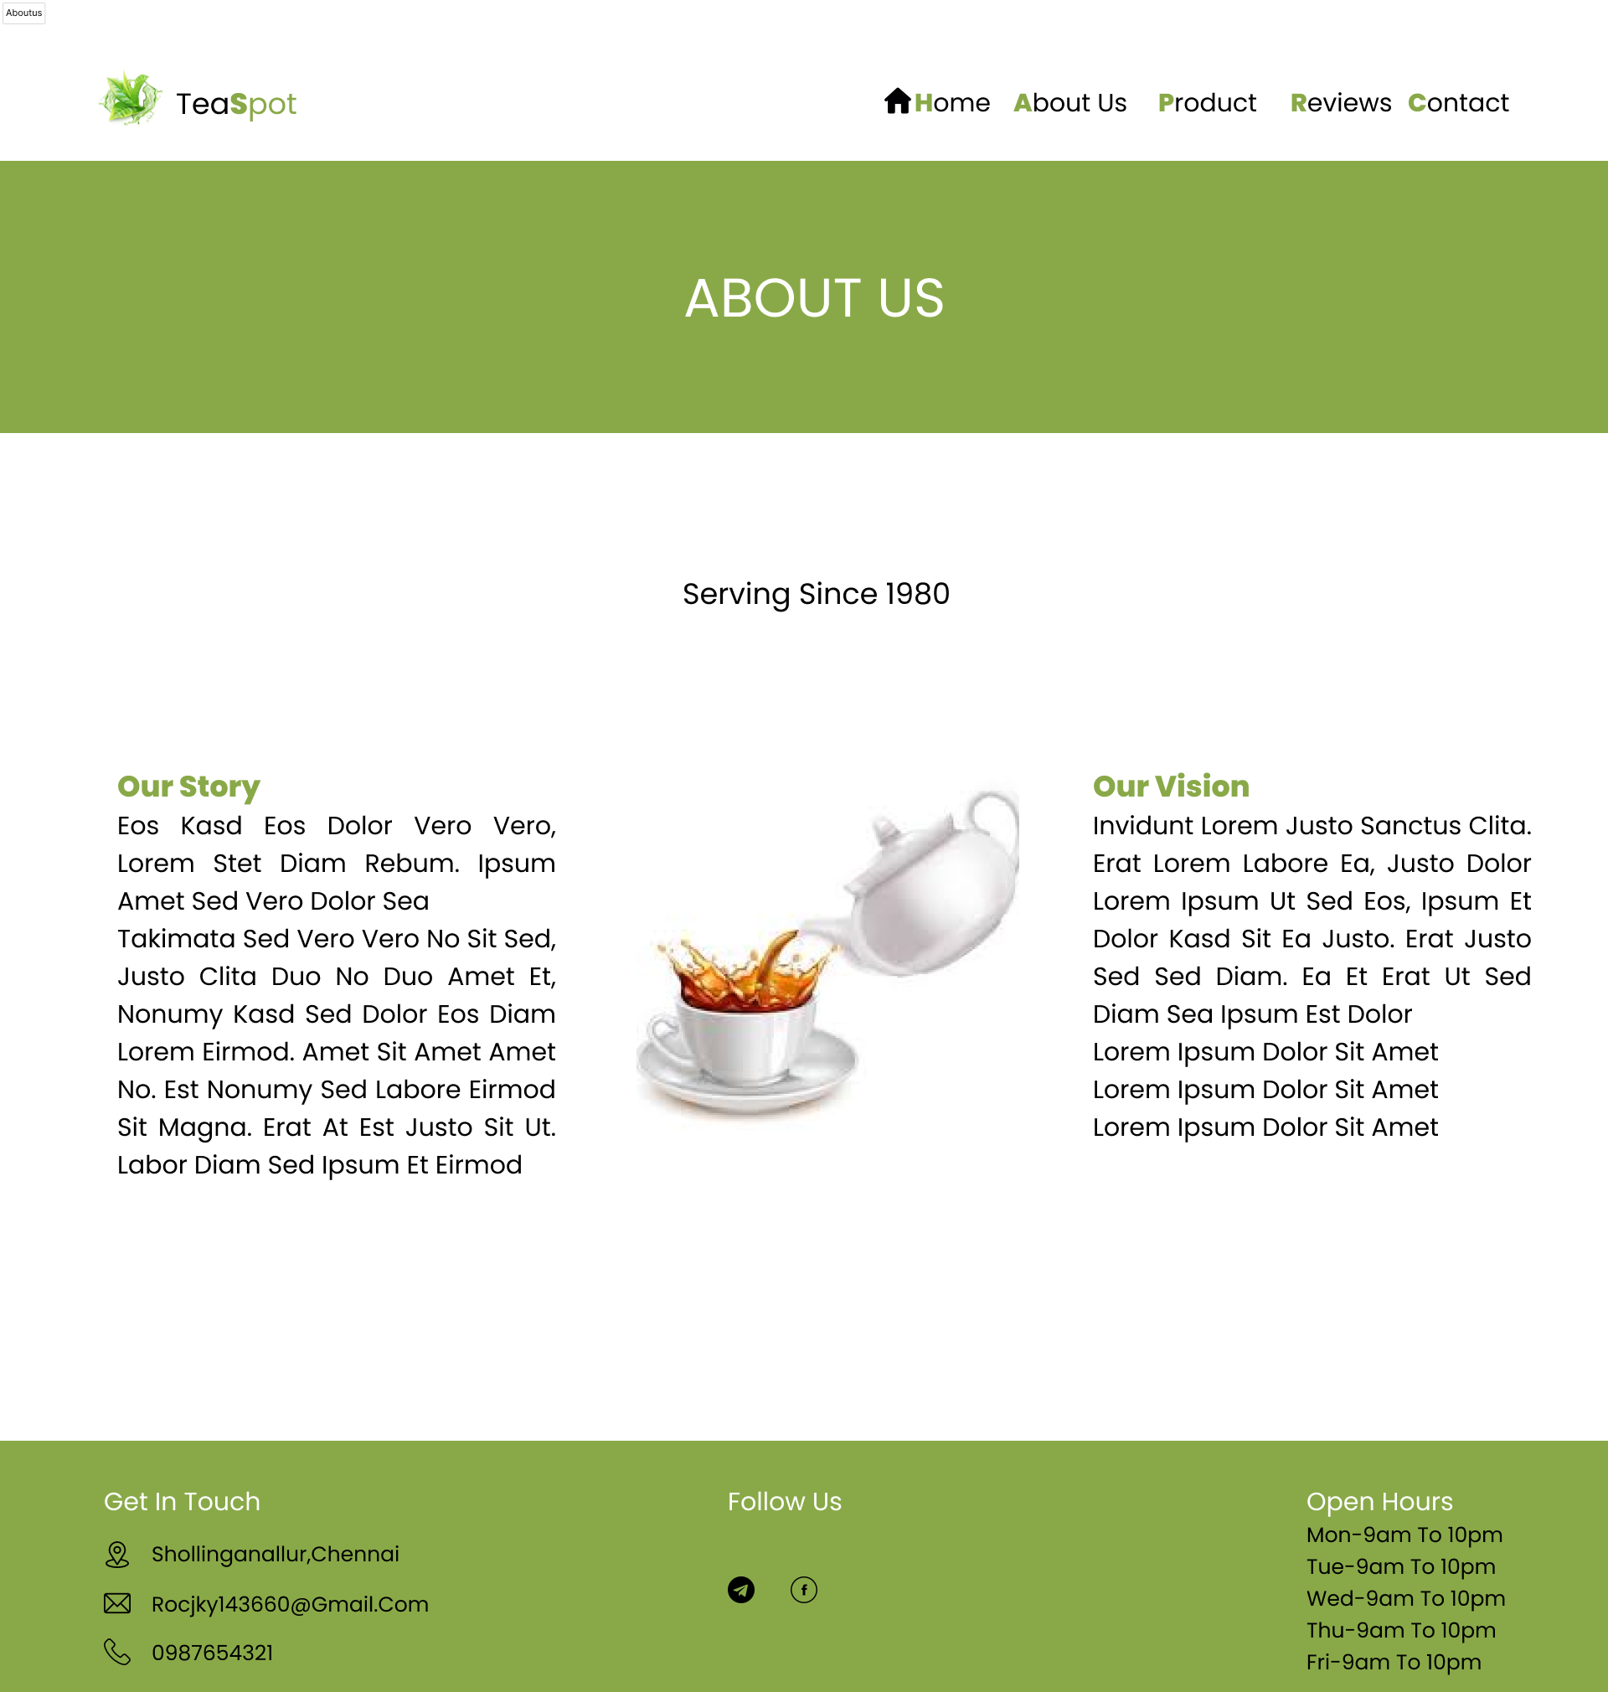
About-us

Slide 6
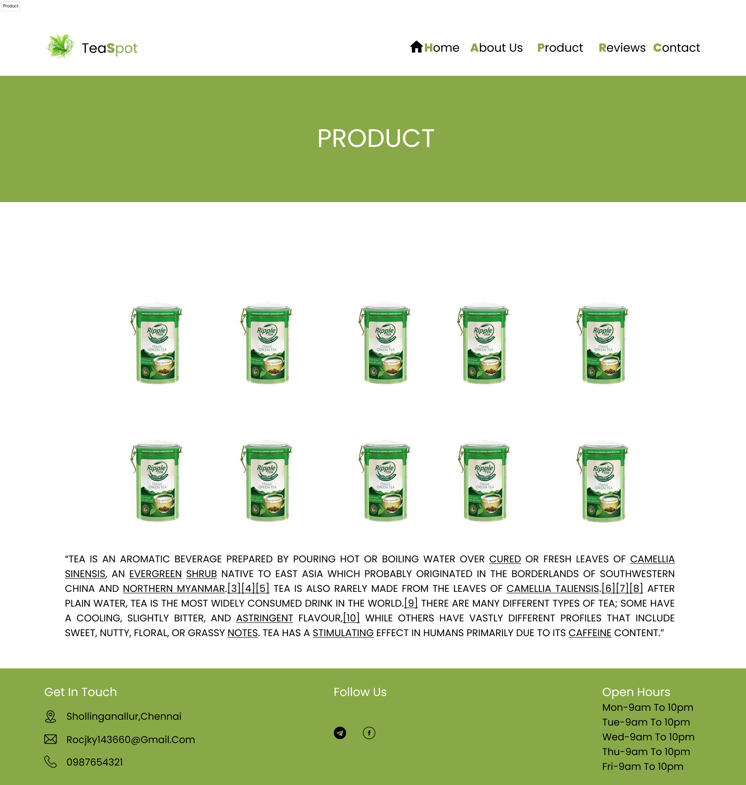
Product

Slide 7
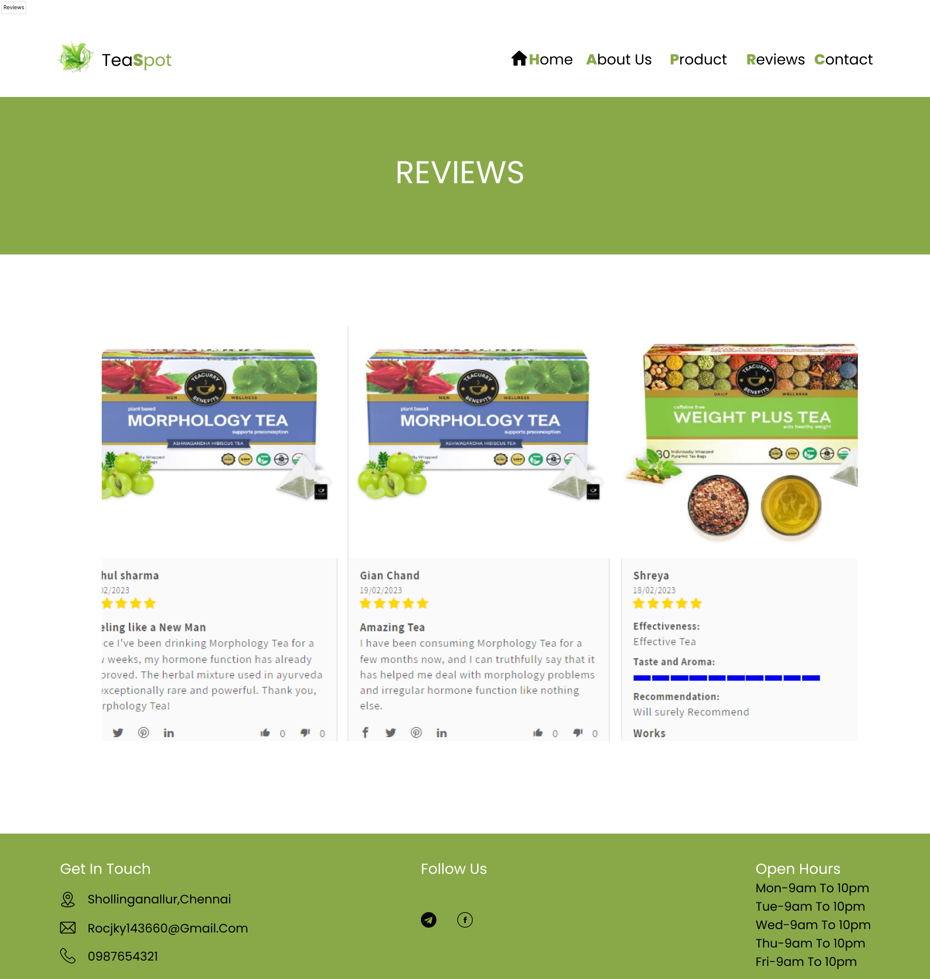
Review

Slide 8
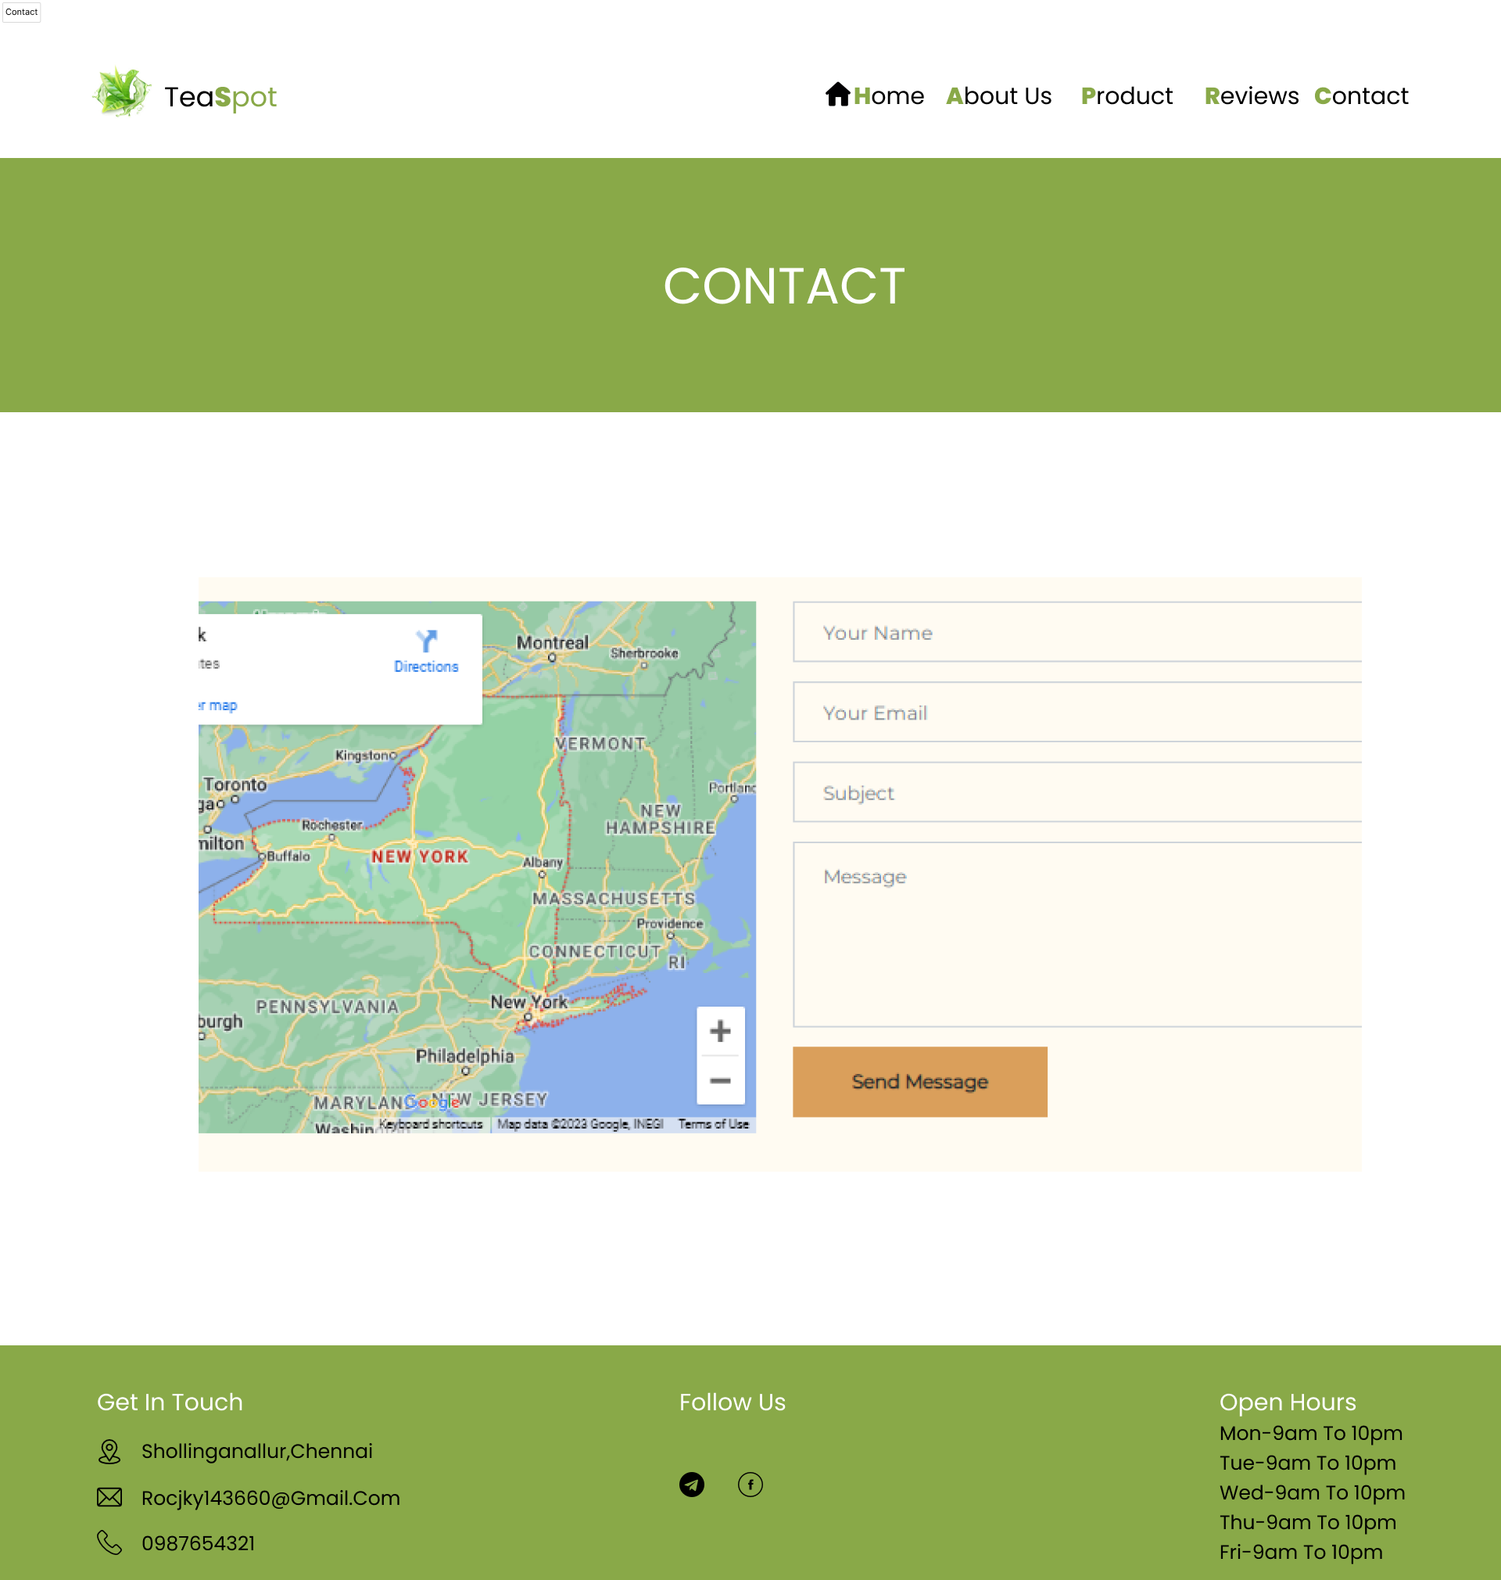
Contact

Slide 9

Thank You!

